Slide 1
FAMILIES FIRST CORONAVIRUS RESPONSE ACT (FFCRA) Q&A SESSION University Staff Council
Human Resources & Organizational Effectiveness
June 16, 2020

Slide 2
Topics to Be Covered
Families First Coronavirus Response Act (FFCRA) Leave Types
FFCRA Eligibility
Basics of New Leave Provisions
Resources Available
Q&A

Slide 3
FFCRA – Paid Leave Types
The Families First Coronavirus Response Act (FFCRA) requires certain employers including Texas A&M University System members to provide two forms of paid leave to assist employees impacted by COVID-19
Emergency Paid Sick Leave (EPSL)
Emergency Family and Medical Leave (EFMLA)
FFCRA

Slide 4
Who has access to FFCRA?
FFCRA leave which includes EPSL and EFMLA is accessible when the employee is UNABLE to perform the assigned duties, either at the normal worksite or remotely, due to specific qualifying, COVID-19-related reasons.

Slide 5
Emergency Paid Sick Leave (EPSL)
Meets 1 of 6
Employee under quarantine or isolation Order
Employee advised to self-quarantine by health provider
Employee Experiencing COVID-19 symptoms & seeking diagnosis
Caring for one advised to quarantine or self-isolate
Experiencing substantially similar conditions
Caring for employee’s child with closed school or child care
Provides up to 80 hours of paid sick leave for employees who are unable to work (including those who are unable to work remotely) AND who meet one of the six qualifying reasons related to COVID-19.
EPSL Request Form

Slide 6
Emergency Family and Medical Leave Expansion Act (EFMLA)
The EFMLA amends and expands the federal Family and Medical Leave Act (FMLA), on a temporary basis (provides 12 weeks of job protected leave).
Qualifications:
Employee is unable to work, including work-from-home (remotely), due to the need to care for the employee’s child (under 18 years of age) when the child’s school or place of care is closed or the child care provider is unavailable due to a public health emergency.
Employed at least 30 calendar days
Available to ALL employee types including faculty, staff, and students
EFLMA Request Form

Slide 7
FFCRA’s Paid Leave
EFMLA Additional 10 weeks
EPSL Up to 80 hours
May overlap with first 2 weeks of EFMLA
Apply to FFCRA leave taken between April 1, 2020, and December 31, 2020.
Any FMLA previously taken by employee during current fiscal year must be subtracted from available EFMLA
Leave types listed in Workday

Slide 8
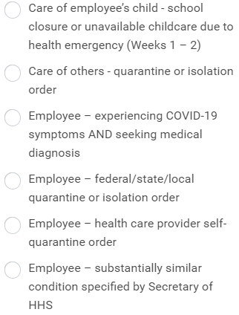
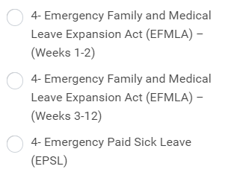
Logging FFCRA Leave in Workday
Submit leave in Workday AFTER forms have been completed and submitted to the unit’s HR Liaison.
Select Qualifying Reason

Slide 9
Logging FFCRA Leave in Workday
If employee qualifies for EPSL & EFMLA, two entry types must be made for weeks 1-2 in order for employee to be paid.
Weeks 3-12 of EFMLA only require one entry type for employee to be paid

Slide 10
Resources
Visit https://employees.tamu.edu/covid-19/FFCRA
FAQs
Request Forms
Workday Job Aid
All leave-related questions concerning the coronavirus, including the use of EPSL or EFMLA, should be emailed to benefits@tamu.edu for TAMU or hschr@tamu.edu for HSC

Slide 11
Question & Answer Session Please type your questions in the chat and refer to the slide number if needed. If you need to articulate your question verbally, then go to the participant panel and raise your hand.

Slide 12
Andy Barna
Director of Employee Relations
Mary Schubert
Director, Office of Strategy Management
Elizabeth Schwartz Director, Total Rewards
benefits@tamu.edu employees.tamu.edu

