Slide 1
Government Relations
Julie Kopycinski
Chief Government Relations Officer
October 2024

Slide 2
Agenda
Roles and Responsibilities
Impact on the Flagship and Branch Campuses
State vs Federal Policy and Funding
Looking Ahead

Slide 3
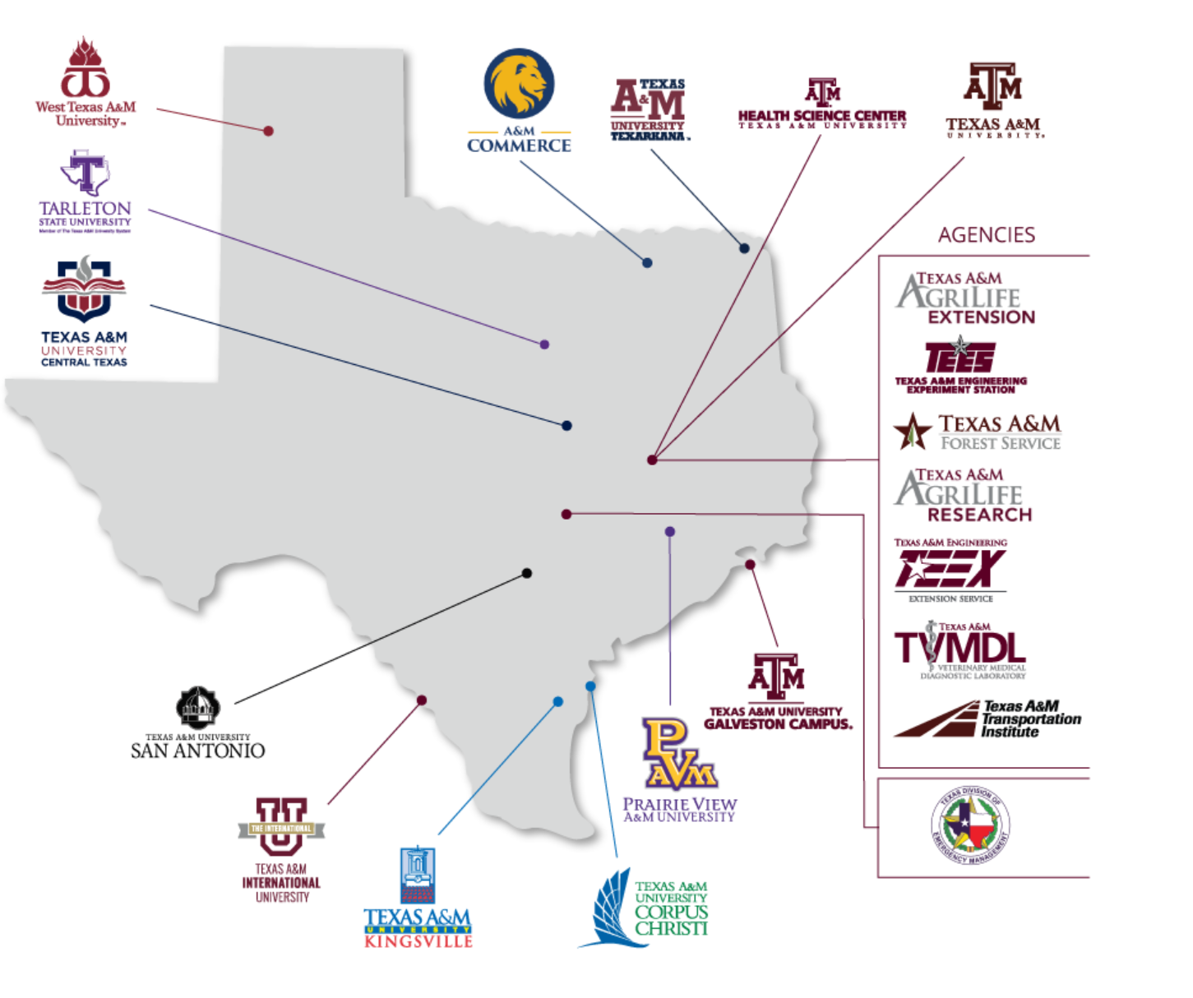
TAMUS Government Relations
11 Institutions
8 State Agencies
Represented By:
15-member state relations team
6-member federal relations team

Slide 4










TAMU Government Relations
Jenny Jones
Vice Chancellor
TAMUS
Joe Cox
Associate Vice Chancellor
External Affairs & Government Relations
AgriLife
Julia Crane
Program Manager for External Relations
AgriLife
Jeff Williford
Assistant Vice Chancellor
Government Relations & External Affairs
TEES, TEEX, TTI
Katy Von Rosenberg
Deputy
TEES, TEEX, TTI
Julie Kopycinski
Chief Government Relations Officer
TAMU, TAMU-G,
McAllen HEC, Law School
Michael Hardy
Deputy Chief and Director of Fed Relations
TAMU, TAMU-G, McAllen HEC, Law School
Kyler Ramsey
Associate Vice President
Government Relations
Health Science Center
Vacant
GR Officer
Government Relations
Health Science Center

Slide 5
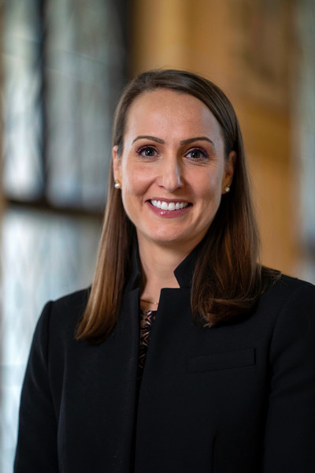
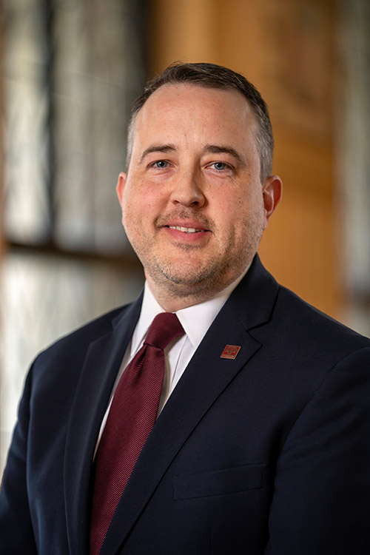
Office of the President GR
Chief Government Relations Officer for Texas A&M University
Class of 2004; BA in Speech Communications
Focus primarily on state relations
Deputy Chief Government Relations Officer for Texas A&M University & Director of Federal Relations
Class of 2013; Master's of Public Service and Administration from the Bush School
Focus primarily on federal relations

Slide 6




Our Portfolio

Slide 7

Responsibilities
System-wide:
Provide a coordinated, system-wide approach to support funding initiatives and achieve policy goals
Maintain relationships with the Texas Legislature, Congressional members, statewide leaders, and state/federal
Support the Chancellor, Presidents, and CEOs and keep them informed
TAMU Specific:
Tell our story! Translate and highlight the great work of our students and researchers
We track, and work to influence, legislative packages and policy discussions
Establish relationship to make us the trusted expert so we are part of the conversation on policy and funding
Lot of constituent work!

Slide 8
Policy

Slide 9
What is Public Policy
Technically:
A system of laws, regulatory measures, funding measures, and other courses of action concerning a given topic that is carried out by a governmental entity or its elected representatives.
Practically:
Crafting a framework for addressing complex challenges that has the potential to dramatically change the lives of others.

Slide 10
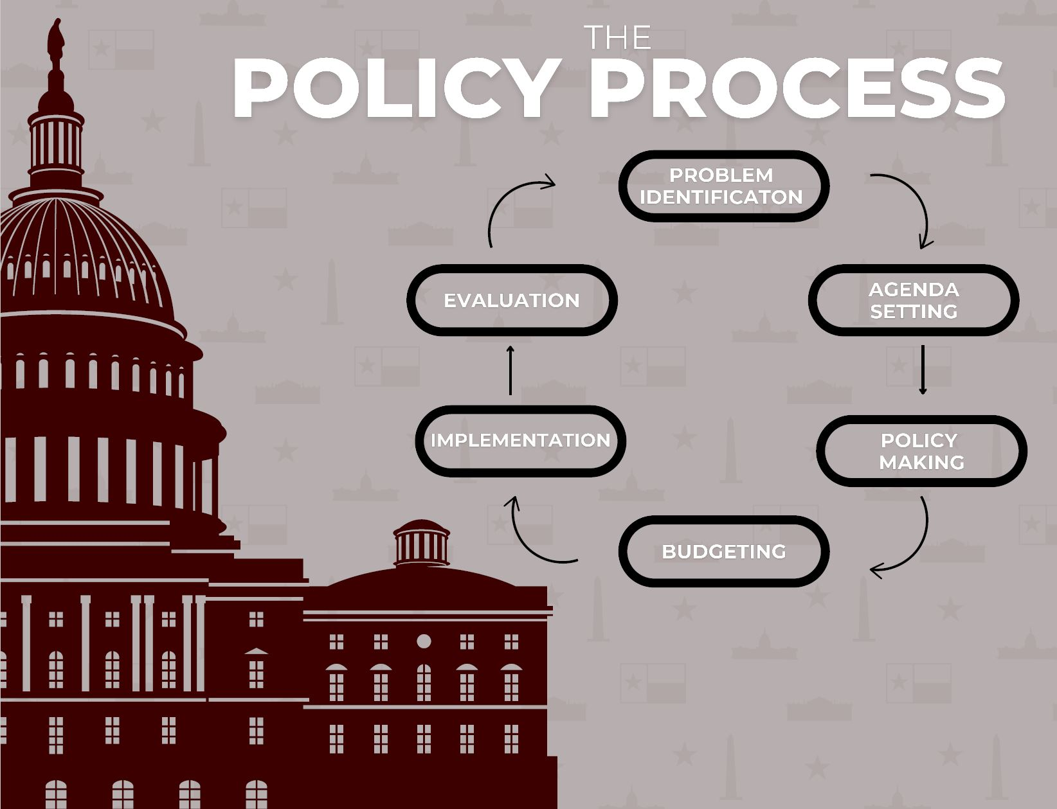
Public Policy Entry Points
There are lots of entry points to impact public policy and legislation.
You can influence each of these six buckets depending on where an issue is in the process and your skillset.

Slide 11
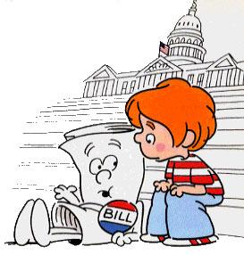
Legislative Branch: Timeline
Congress
A session of Congress is one year long. Each term has two sessions.
Any Member in the House of Representatives may introduce a bill at any time while the House is in session.
State Legislature
Meet for 140 days every 2 years.
Can only file bills the November before the session through March.
Next session starts January 2025,

Slide 12
Potential Upcoming State Legislation
Stopping DEI to Strengthen the Texas Workforce: Examine programs and certificates at higher education institutions that maintain discriminatory diversity, equity, and inclusion (DEI) policies. Expose how these programs and their curriculum are damaging and not aligned with state workforce demands. Make recommendations for any needed reforms to ensure universities are appropriately educating students to meet workforce needs.
Core Curriculum Course Accessibility: Review student access to core curriculum courses at Texas institutions of higher education. Examine the availability of these courses both online and in-person, as well as any issues that would prevent or reduce in-person access. Make recommendations for any needed reforms to ensure that all students have equal in-person access to core courses.
Student Athlete Compensation: Review the status of “Name, Image & Likeness” (NIL) across the state and the country.
Combating Antisemitism on Texas College Campuses: Review campus policies to prevent antisemitism. Study the oversight Texas institutions of higher education have over the formation and operations of student organizations, including access to campus facilities and use of campus property. Make recommendations to prevent antisemitism on college campuses, while protecting First Amendment rights.

Slide 13
(Continued)
Higher Education - “Faculty Senates”: Review and analyze the structures and governance in higher education, focusing on the role of “faculty senates,” and like groups, in representing faculty interests to higher education institution administrations. Make recommendations to establish guidelines for the role and representation of faculty by “faculty senates,” and like groups, at higher education institutions in Texas.
Innovation and Technology in Higher Education: Investigate the opportunities and challenges of emerging technology on teaching and learning, focusing on artificial intelligence (AI), online education, and digital resources.
Campus Free Speech: Examine the procedures of Texas public institutions of higher education designed to protect the First Amendment free speech rights of faculty, staff, and students. Monitor and report on compliance Senate Bill 18, 86th Legislature, and make recommendations for any needed reforms.

Slide 14
Funding

Slide 15





State & Federal Key Funding Differences
State
Federal
150 Representatives & 31 Senators
38 Congressman & 2 Senators
Meet for 140 days every odd numbered year
Meets year round; each Congress lasts for 2 years
$321.3 Billion Budget
FY 23 $1.7 Trillion
Discretionary Budget
Funds must be used within 2 years
Length of funding varies by program
How does this impact my constituents? What can I point to?
How does this impact my constituents? What can I point to?

Slide 16
How Do We Develop Our Funding Requests
Top Down
President sets the priorities
Bottom Up
Researchers Submit Ideas

Slide 17
Federal Funding Opportunities
Programmatic Request
Members of Congress can submit a programmatic request to fund an existing program at a certain level or prioritize it within an agency’s suite of activities.
Examples:
Support the FY24 budget request of $1.18 billion for the NSF TIP Directorate
Increase funding for the Nuclear Energy University Programs
Programmatic Plus-Up
An appropriations request that would add additional funding to an existing federal program office/department for a specific purpose or activity.
Example:
Request to support the Ballistic, Aero-Optics, and Materials Test Range (most effective when you have an established relationship)

Slide 18
Federal Funding Opportunities Continued
Community Project Funding (Earmarks)
Never a guarantee
Members of Congress may submit requests for funding for a particular project at a particular entity
Not all accounts are eligible and funding levels vary by account
You must provide evidence of community support for the project (letters, articles)
Not all members choose to submit earmarks. Those that due are limited to 10 submissions.
FY 25 Texas A&M University Appropriations Requests Examples:
Support the FY24 budget request of $1.18 billion for the NSF TIP Directorate
International Ocean Discovery Program – Potentially $25,000,000
Veterinary Emergency Team (VET) Funding - $6,000,000
State Maritime Funding (TAMUG/TAMMA) – Likely between $100-$125M
Cyclotron Institute Funding – Level funding to FY24
There is a continuing resolution through December 20th. This is a temporary funding measure that Congress can use to fund the federal government for a limited amount of time

Slide 19
What is a State Exceptional Item
Exceptional Items are requests for funding of amounts greater than the baseline request
Funding for an Exceptional Item may be requested for an existing Special Item or a newly proposed one
All 11 TAMUS Institutions and 8 Agencies submit Exceptional Items
These are for demonstrated need at the state level – not just research on a topic

Slide 20
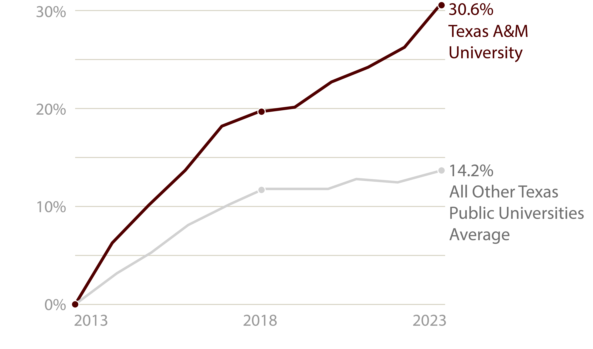
10-YEAR ENROLLMENT GROWTH
TEXAS A&M’S growth is more than
DOUBLE
the average growth other Texas public universities in the PAST DECADE
SOURCE: PREP Online (state.tx.us)
Notes:
The demand for a Texas A&M University degree continues to grow. In fact, our student body has grown more than 30% over the last 10 years. That growth matches the state’s population growth and is more than double the average of all other public universities in the state. Importantly, and consistent with our land-grant mission, 94% of our students are Texans and we are working hard to keep the best and brightest close to home.

Slide 21
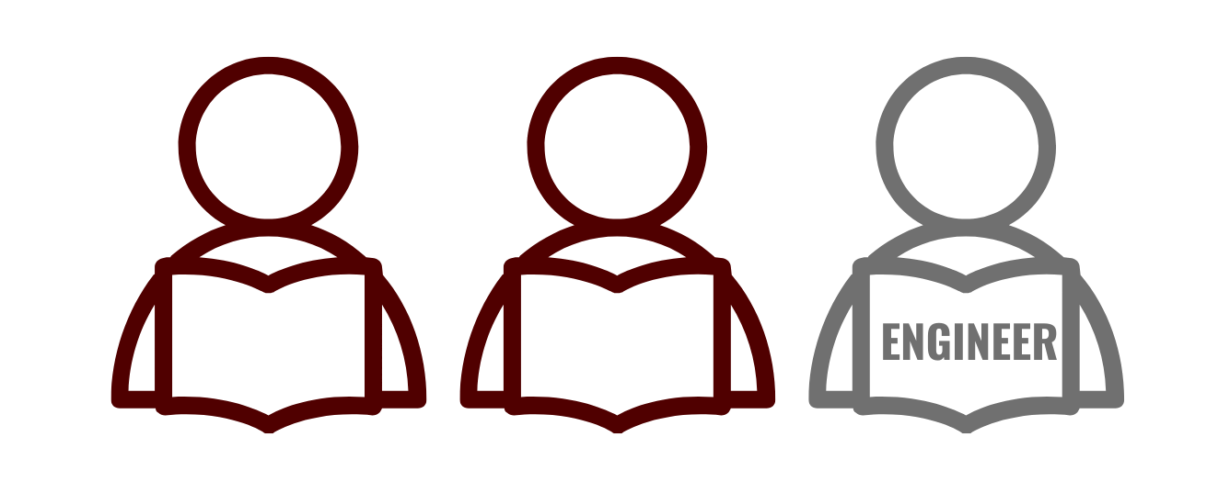

NEXT GENERATION NEEDS
1in3
EXCEPTIONAL ITEM REQUEST
$45 million
Aggie Students Are Engineers
SOURCE: Texas Workforce Commission’ Texas Workforce Report 2022 to 2023
Notes:
As we’ve grown, we’ve continued to graduate leaders of character with the STEM skills and expertise required to lead in high-demand, high-tech jobs in Texas. The number of STEM degrees being awarded at A&M is up 44% over the past decade, while our engineering degrees have increased 75% in that same time frame. Today, one out of every three students at Texas A&M is an engineering student.
But we’re not just preparing tomorrow’s STEM leaders, we’re also the No. 1 producer of certified teachers in the critically important fields of math and science.
But we’ve reached a tipping point. In some cases, our STEM department faculty are facing a 32:1 student-to-faculty ratio, a long way from the ideal ratio of 23:1. Our student support staffs have similarly been left behind in some areas by the rapid student body growth. Until now, we’ve made up for those shortfalls by increasing the workload on our faculty and staff. That shouldn’t be the long-term solution. We need to right-size our faculty and student support staff to maintain our quality of education over time.
Academic and social support for students is much more complex than it used to be – and it’s driving up the cost of higher education, which is why we also want to continue the momentum from the last session related to formula funding.
Our exceptional item request of $45M over FY 24/25 funding levels will provide for additional faculty and student support staff in our STEM-related degree programs. This will allow us to meet the demands of students and the market while driving continued economic growth in the State. Without this additional funding, we will have to stop growing our STEM degree programs – and we don’t think that’s what’s best for Texas.

Slide 22

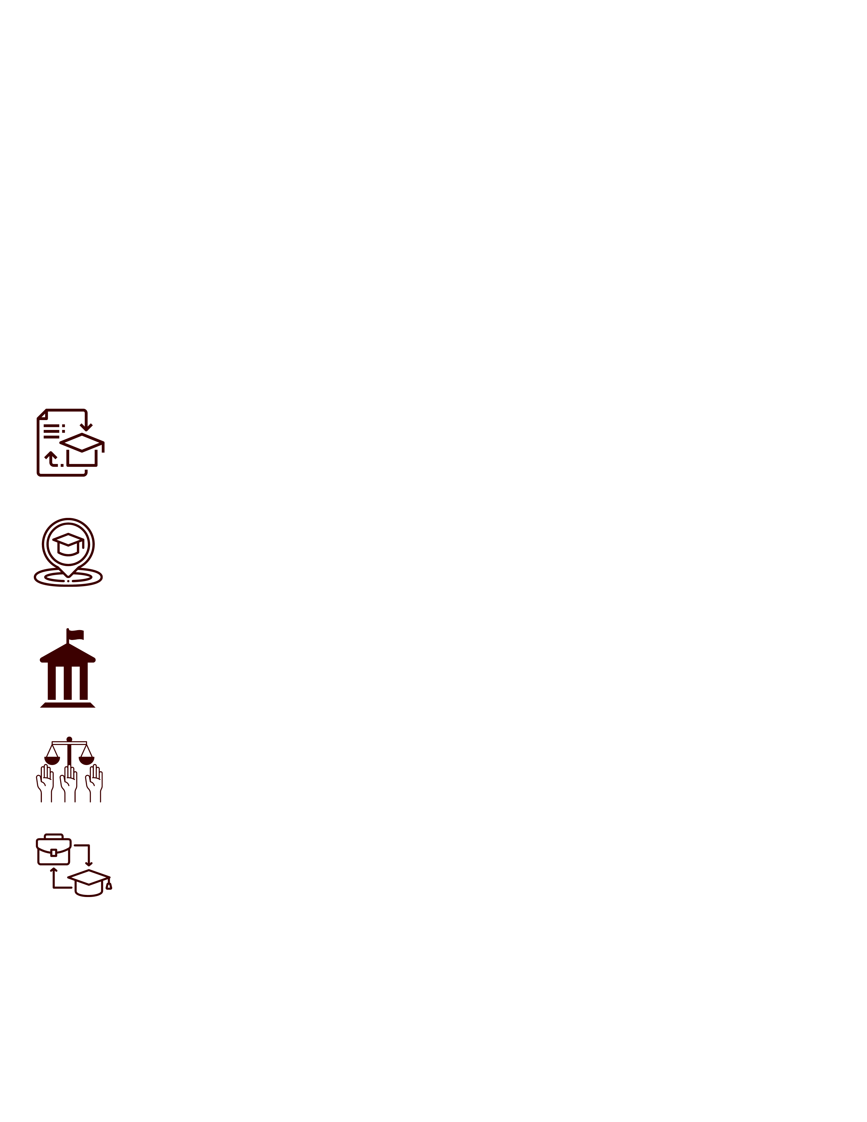
CITIZENSHIP & SERVICE
Graduating great citizens prepared to passionately pursue their purpose
Curriculum
Governor’s School
City and County Government Program
Citizenship and Democracy Research
Public Service/Internships/Workforce Preparation
Notes:
As we reinforce our ability to continue providing high-quality STEM education, we’re also focused on using our values-based educational model to graduate not just great Aggies, but great citizens.
That’s why we’re launching the Citizenship and Service Initiative. Our intent is to take an even more deliberate approach to instilling citizenship skills in our students.
The initiative’s multi-faceted approach will prepare students from every degree program to embrace careers in public service, or to engage voluntarily in their future communities as responsible, informed, and engaged citizens.

Slide 23



Supporting the Texas Workforce
Texas ports support 25% of Texas GDP
Companies seek to hire over 1,000 of these graduates in Texas this year.
Texas A&M is the only source of specialized graduates to serve as officers on commercial ships in the Gulf Coast Region.
High cost to students deters entry into the program. Costs will double with the arrival of the TS Lone Star State in late 2025.
TEXAS A&M MARITIME ACADEMY
EXCEPTIONAL ITEM REQUEST:
$16 million over 2 years ($8 million annually)
6

Slide 24
Wrap Up

Slide 25




Reality of the Job
Making policy is a slow, sometimes painful process.
There are lots of cooks in the kitchen which can be frustrating.
The process is a giant chess game – you have to always be thinking about the next move.
Sometimes you to make incremental changes.

Slide 26
Questions?

